Slide 1


10. File structure
Notes:
NOTE:
To change the image on this slide, select the picture and delete it. Then click the Pictures icon in the placeholder to insert your own image.

Slide 2
Content
10.1 Text versus Binary
10.2 Access methods

Slide 3
Objectives
After studying this chapter, the student should be able to:
Define two categories of access methods: sequential access and random access.
Understand the structure of sequential files and how they are updated.
Understand the structure of indexed files and the relation between the index and the
data file.
Understand the idea behind hashed files and describe some hashing methods.
Describe address collisions and how they can be resolved.
Define directories and how they can be used to organize files.
Distinguish between text and binary files.

Slide 4
1 - Access methods

Slide 5
1. Introduction
Files are stored on auxiliary or secondary storage devices. The two most common forms of secondary storage are disk and tape. Files in secondary storage can be both read from and written to. Files can also exist in forms that the computer can write to but not read. For example, the display of information on the system monitor is a form of file, as is data sent to a printer. In a general sense, the keyboard is also a file, although it cannot store data.
Figure 10.1 A taxonomy of file structures

Slide 6
2. SEQUENTIAL FILES
A sequential file is one in which records can only be accessed one after another from beginning to end. Figure 13.2 shows the layout of a sequential file. Records are stored one after another in auxiliary storage, such as tape or disk, and there is an EOF (end-of-file) marker after the last record.
Figure 10.2 A sequential file

Slide 7
Example
Algorithm 10.1 shows how records in a sequential file are processed. We process the records one by one. After the operating system processes the last record, the EOF is detected and the loop is exited.
Algorithm 10.1 Pseudocode for processing records in a sequential file

Slide 8
3. INDEXED FILES
To access a record in a f﻿ile randomly, we need to know the address of the record. For example, suppose a customer wants to check their bank account. Neither the customer nor the teller knows the address of the customer’s record. The customer can only give the teller their account number (key). Here, an indexed file can relate the account number (key) to the record address (Figure 13.5).
Figure 10.3 Mapping in an indexed file
Figure 10.4 Logical view of an indexed file

Slide 9
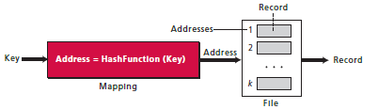
4. HASHED FILES
In an indexed file, the index maps the key to the address. A hashed file uses a mathematical function to accomplish this mapping. The user gives the key, the function maps the key to the address and passes it to the operating system, and the record is retrieved (Figure 10.5).
Figure 10.5 Mapping in a hashed file

Slide 10
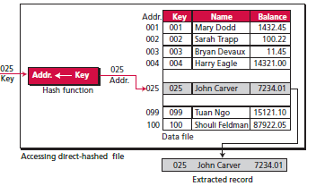
Hashing methods
Direct hashing
In direct hashing, the key is the data file address without any algorithmic manipulation. The file must therefore contain a record for every possible key. Although situations suitable for direct hashing are limited, it can be very powerful because it guarantees that there are no synonyms or collisions (discussed later in this chapter), as with other methods
Figure 10.6 Direct hashing

Slide 11
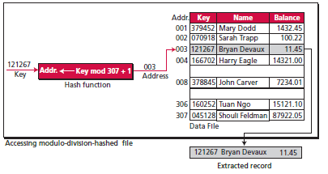
Hashing methods (cont)
Modulo division hashing
Also known as division remainder hashing, the modulo division method divides the key by the file size and uses the remainder plus 1 for the address. This gives the simple hashing algorithm that follows, where list_size is the number of elements in the file. The reason for adding a 1 to the mod operation result is that our list starts with 1 instead of 0:
Figure 10.7 Modulo division

Slide 12
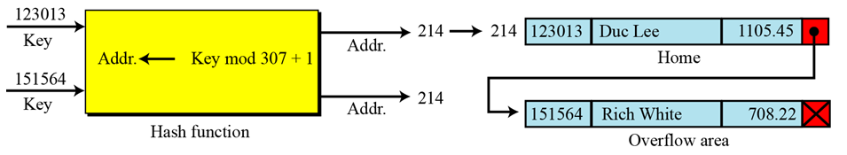
5. Collision resolution
When we hash a new key to an address, we may create a collision.
There are several methods for handling collisions, each of them independent of the hashing algorithm. That is, any hashing method can be used with any collision resolution method
Figure 13.11 Open addressing resolution
Figure 10.8 Linked list resolution

Slide 13
2- Text versus Binary

Slide 14
1. TEXT VERSUS BINARY
Two terms used to categorize files: text files and binary files. A file stored on a storage device is a sequence of bits that can be interpreted by an application program as a text file or a binary file, as shown in Figure 13.15.
Figure 10.9 Text and binary interpretations of a file

Slide 15
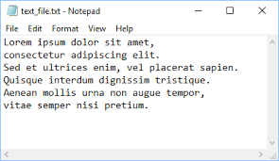
2. Text File
A text file is a file of characters. It cannot contain integers, floating-point numbers, or any other data structures in their internal memory format. To store these data types, they must be converted to their character equivalent formats.
Figure 10.10 Text file

Slide 16
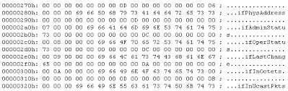
3. Binary files
A binary file is a collection of data stored in the internal format of the computer. In this definition, data can be an integer (including other data types represented as unsigned integers, such as image, audio, or video), a floating-point number, or any other structured data (except a file).
Figure 10.11 Binary file

Slide 17
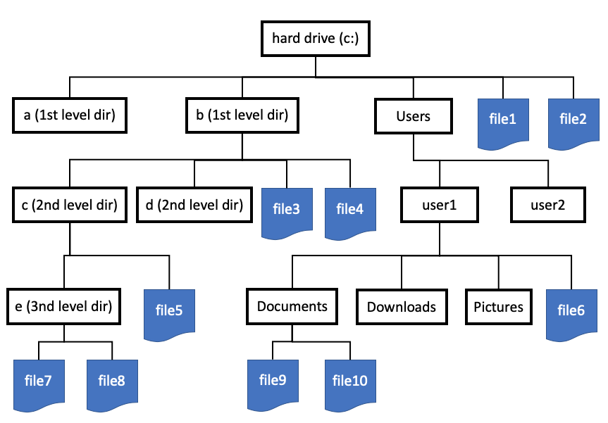
4. DIRECTORIES
Directories are provided by most operating systems for organizing files. A directory performs the same function as a folder in a filing cabinet. However, a directory in most operating systems is represented as a special type of file that holds information about other files.
A directory not only serves as a kind of index that tells the operating system where files are located on an auxiliary storage device, but can also contain other information about the files it contains, such as who has access to each file, or the date when each file was created, accessed, or modified.
Figure 10.12 Directories in Window

